Slide 1
WASM FUZZING
Team Members：
张艺凡 11711335
余添诚 11712019
胡玉斌 11712121
Supervisor: 刘烨庞老师

Slide 2
Outline
Briefing of WASM Fuzzing
Project Evaluation

Slide 3
Briefing
Definition:
Fuzzing test on WebAssembly virtual machines.
Goal:
Hopefully to find bugs.

Slide 4
Briefing
What we’ve done:
1. WebAssembly Fuzzing test Platform.
2. Several mutation on WebAssembly code, including but not restricted to adding dead code, delete dead code…
3. Large scale testing

Slide 5
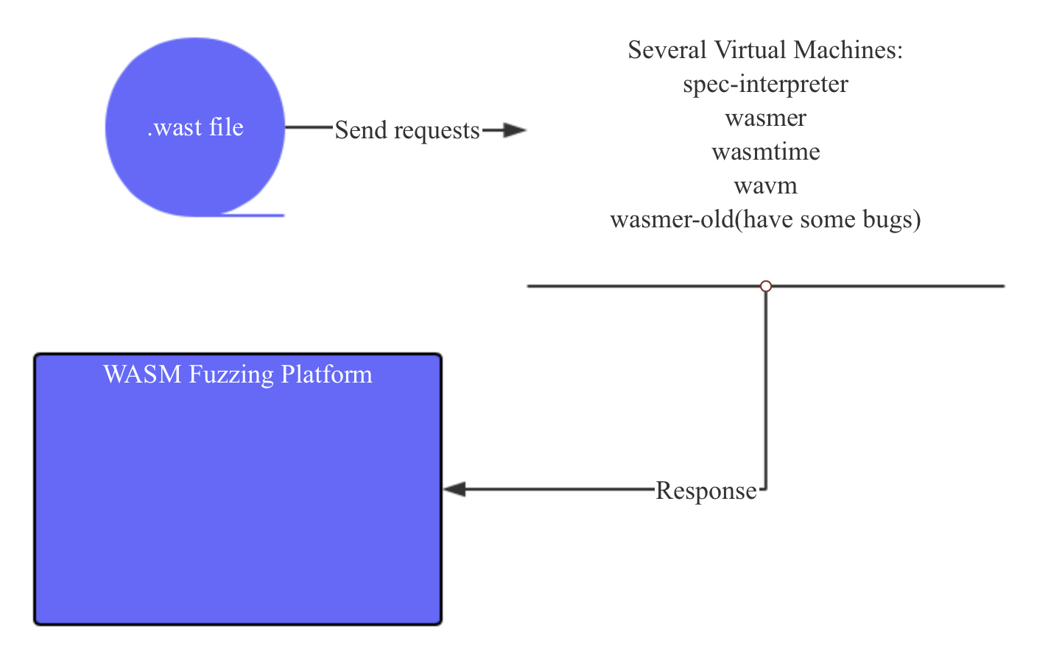
Briefing
Platform:

Slide 6
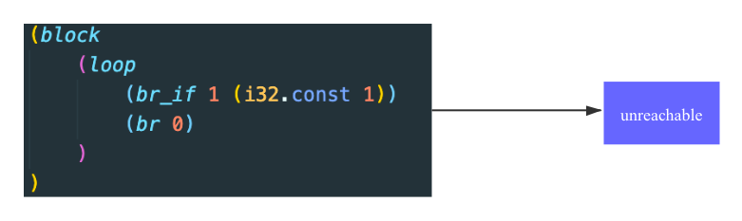
Briefing
Mutation:
Minus-Mutation

Slide 7
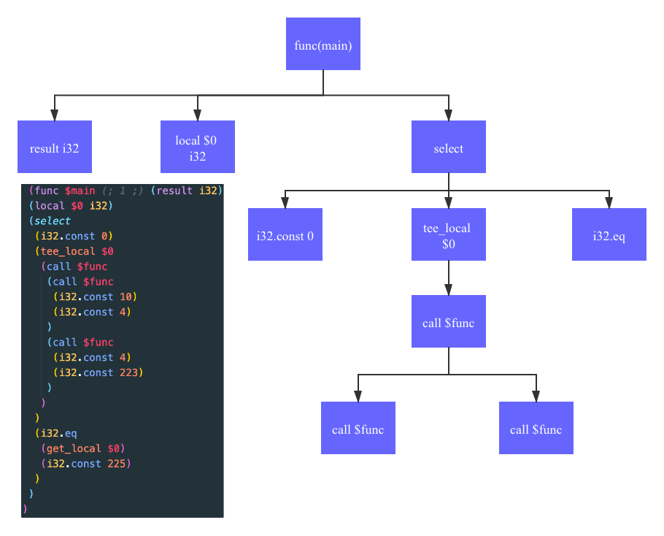
Briefing
Mutation:
Add-Mutation

Slide 8
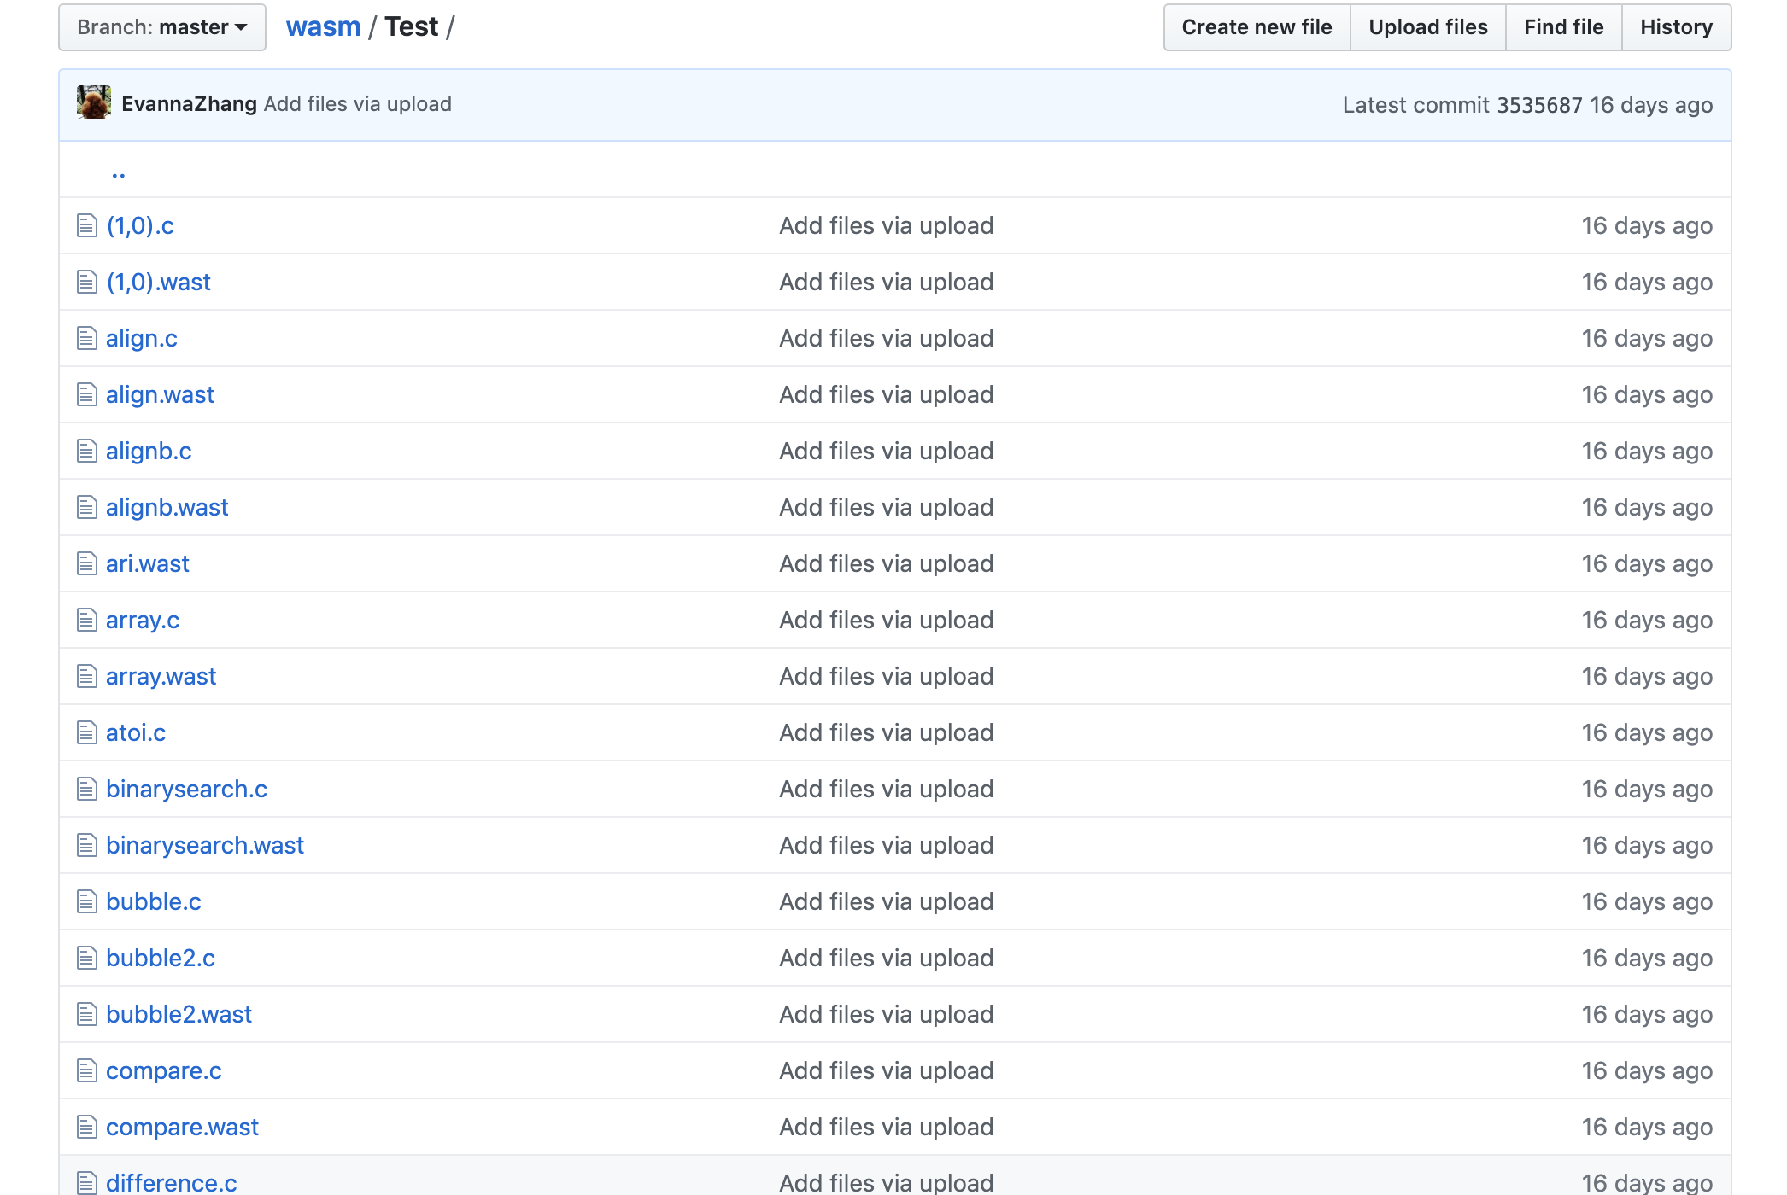
Briefing
Over 60 test suites.
Testing:

Slide 9
Evaluation
For now:
No bug detected ☹
So, we used to method to verify the validity of our experiment.
We added a older version of wasmer

Slide 10
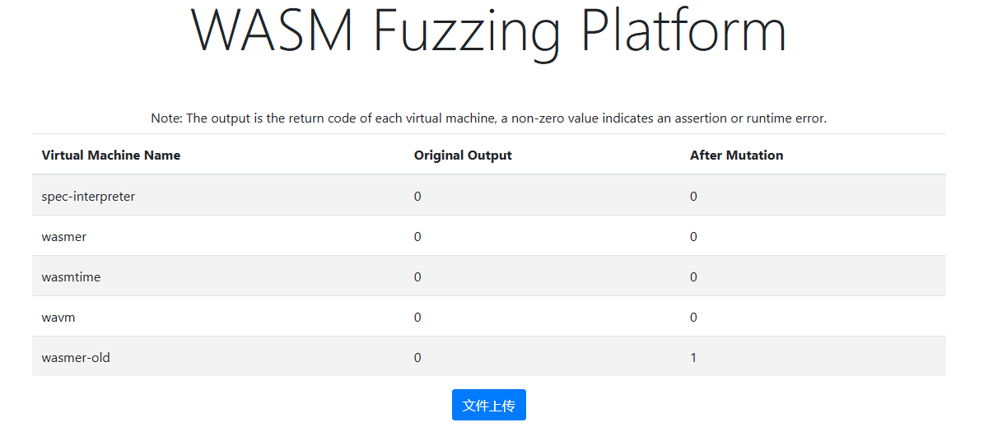
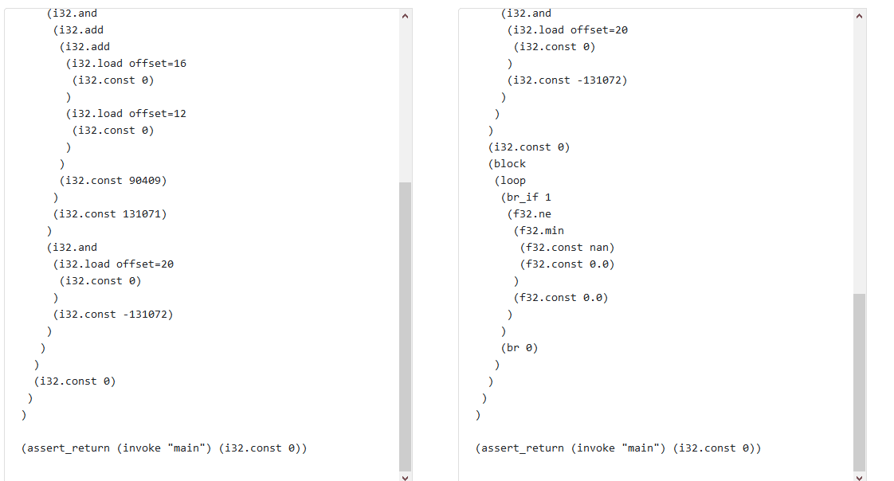
Evaluation
Bug detected

Slide 11
Evaluation
Didn’t detect any new bugs.
Problem:
1. Mutation too simple.
2. Test data not complex enough. Need even more.

Slide 12

Questions & Answers

